Slide 1
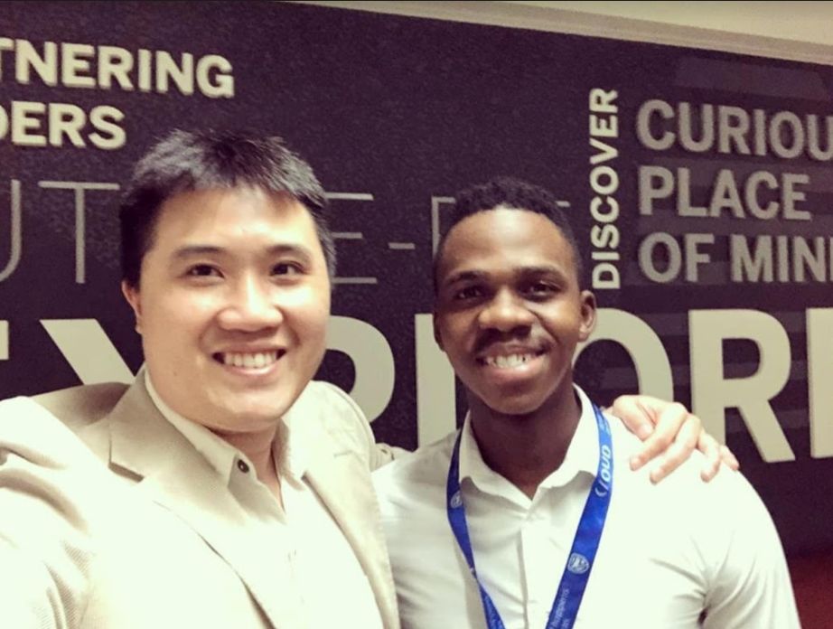


Thomas - TheRobot
Frank Letswalo | AWS Tech-U Graduate
Jeremy Chen | AWS Tech-U Instructor
Frank Letswalo
© 2020, Amazon Web Services, Inc. or its Affiliates. All rights reserved.

Slide 2
AGENDA
Problem Statement
How I came up with a solution
Services I used
Architecture walkthrough
Monitoring
Wrap up
© 2020, Amazon Web Services, Inc. or its Affiliates. All rights reserved.

Slide 3
Problem Statement
Looking at the branch services within Standard Bank there are defects that can be addressed using automated-systems to allow branch employees to focus on more important tasks and to improve customer experience.
e.g It’s September 31st, branches gets occupied and it becomes more busier. A customers walks in and doesn’t find anyone in the Front Desk and then they join a queue assuming it will take them to the right consultant that will query their needs. Only to find out that after 2H:30 of waiting they are in the wrong queue or they don’t have the required documents for that certain query. It becomes really frustrating for a customer to enjoy their experience within the branch
© 2020, Amazon Web Services, Inc. or its Affiliates. All rights reserved.

Slide 4

How I came up with a solution?
Thomas
I decided to come up with a solution that can allow the clients who come to the branch to have a system to respond to their queries (what they would like to do in the branch) when the front-desk assistant is not available at their desk.
© 2020, Amazon Web Services, Inc. or its Affiliates. All rights reserved.

Slide 5
Contact me for more…
Email: frankroger646@gmail.com
Call: 081 318 8976
LinkedIn: Frank Letswalo
© 2020, Amazon Web Services, Inc. or its Affiliates. All rights reserved.

